Slide 1
The New Republic (1789-1816)
Chapter 6

Slide 2
Govt. and Party Politics
Section 1

Slide 3
The Set Up
USA is 52 million in debt
Only 3 million people / farming economy
No navy
Army = 400 people

Slide 4
New Offices
President = George Washington
Secretary of State (foreign policy) = Jefferson
Attorney General (head lawyer) = Randolph
Secretary of War (no longer exists) = Henry Knox
Treasury (finances) = Alexander Hamilton

Slide 5
How to Interpret (read) the Constitution
Loose
Strict
Do not have to follow it word for word
Use it as a “guideline” only
Needs to be followed word for word
Exactly how its written

Slide 6
Example
2nd amendment gives us the right to bear (have) arms (weapons)
What WEAPONS does this refer to? Guns?
What type of weapons? Pistols? Rocket launchers?
Who should get to purchase them? Everyone? Criminals? 8 year olds?

Slide 7
Planning a Capital City
1789 – Capital is in NYC (1st)
1790 – Moved to Philadelphia PA while a capital city could be built near Mount Vernon (Washington’s home)
They would call this the District of Columbia to honor CHRISTOPHER COLUMBUS

Slide 8
Washington D.C
Renamed Washington’s District of Columbia after his death in 1799
Pierre L’Enfant creates plans for two buildings:
The White House ( Presidents mansion )
The Capitol (Congress’s new home)

Slide 9
Washington’s Death
Most likely due to EPIGLOTTITIS (inflammation of the back of tongue) and the treatment
Usually caused by INFLUENZA
5 pints of blood removed which probably led to his death (9-12 total in adults)
Asked for 3 days before his burial for fear of being buried alive

Slide 10
Capitol Building White House

Slide 11
You make $1k per week: Would You Rather……
Option A:
Pay $200 in taxes
Have a powerful army / better defended
Have less money
Option B:
Pay $150 in taxes
Have a small army / less defense
Have $50 more a week for yourself

Slide 12
Federalists
Strong central govt. (President w/ a lot of power)
National bank ( one currency )
Favored using national debt to establish CREDIT(Borrow from other countries)
For strong army and navy (expensive, but powerful)

Slide 13
Jeffersonian Republicans
Favored weak national govt. ( weak president)
Against a national bank ( each state different currency)
Pay off NATIONAL DEBT ( do not borrow )
Against standing army ( Less taxes / less powerful)

Slide 14
Whiskey Rebellion
Same protests as those in Shays’ Rebellion (High taxes)
Summer 1794 Washington exerts new military’s power
Sends 12,000 troops to Pittsburgh to put down rebellion

Slide 15
Section 1 Review:
1. How big was the Navy? Army?
2. Who was the 1st President? Treasurer?
3. What does loose construction mean?
4. Where was the 1st capital built? Where is it now?

Slide 16
Foreign Policy and Election
Section 2

Slide 17
Electoral College (Current)
Need 270 to win (President Only)
538 Electoral Votes
Senators + Representatives = Electoral Votes
(Both are congress)

Slide 18
Electoral Votes
Each state has 2 senators (fixed): 100 total
The number of Representatives vary depending on population ( 435 total + 3 D.C = 438)
538 total electoral votes
Example: PA has 18 Representatives and 2 senators for 20 electoral votes

Slide 19
Election 1796
Washington decides not to run
John Adams (Federalist) defeats Thomas Jefferson (Republican) 71 – 68
Becomes 2nd president of the U.S
Jefferson becomes vice president

Slide 20
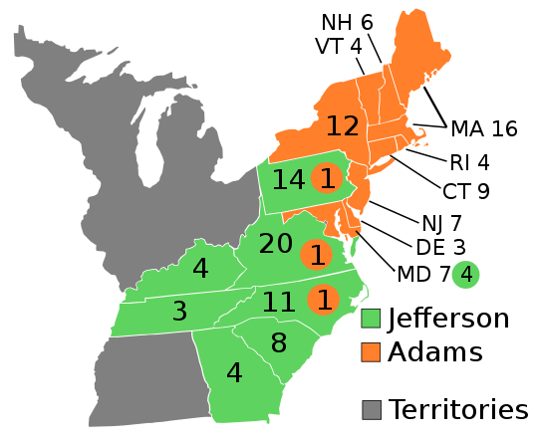

Slide 21
Alien and Sedition Acts (Adams)
Gave president power to DEPORT non citizens
Naturalization process changed from 5 to 14 years
Negative talk against Am. Govt. could get you fined or jailed
Security

Slide 22
VA and KY Resolutions
Gave these two states powers to judge if a law is constitutional or not
Showed defiance towards the federal govt.
Ex. If the U.S wanted to ban soda nationally, these states could say they didn’t have to

Slide 23
The Campaign (1800)
Negative Campaigning
Republicans call Adams a monarchist
Federalist called Jefferson “Godless”
Separated Adams from Washington

Slide 24
Jefferson’s Victory (1800)
Jefferson beats Adams with 73 - 65 electoral votes
Jefferson and Burr tied 73 – 73
The House of Representatives were given the power to choose the new president
Hamilton persuades them to vote JEFFERSON as 3rd president

Slide 25
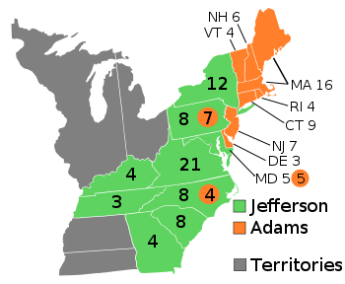
1796
1800

Slide 26
Section 2 Review:
1. How many electoral votes to win the presidency? How many total?
2. How many senators does each state have? Does this ever change?
3. What type of campaigning was used between Adams and Jefferson?
4. Who won the election of 1800?

Slide 27
The Age of Jefferson
Section 3

Slide 28
New Policy
Cut national debt from 80M to 57M
Made cuts to army and navy budget
Sold land to Americans moving West
More INCOME, less DEBT

Slide 29
John Marshall
Chief Justice of the Supreme Court
1. Gave the Supreme Court power to review laws made by Congress
2. Federal laws were superior to state laws
3. Loose interpretation of Constitution

Slide 30
Louisiana Purchase 1803
French Empire in America grew food for Haitian sugar farmers (French controlled)
After a rebellion in Haiti, France no longer needs to feed them
Sell land for 15 million (Doubles size of US)
500M acres / .03 cents per acre

Slide 31
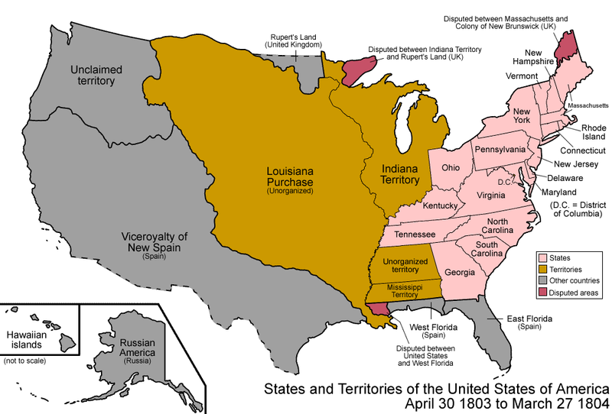

Slide 32
Lewis and Clark Expedition 1804
Goal: Find river route to Pacific
Come in contact with Native Americans
Gather information about the resources of the land / name dozens of plant and wildlife species

Slide 33
Aaron Burr v. Alexander Hamilton
Burr runs for governor of NY as a Federalist
Hamilton distrusts Burr and tells his friends not to support him / loses election
Burr challenges Hamilton to a duel and shoots him in the chest, mortally wounding him

Slide 34
Duel
Challenge someone by smacking with a glove (over disrespect)
Duelists would agree on the TERMS of the duel
Usually meant to not harm the other / just earn respect (miss shot on purpose)

Slide 35
Section 3 Review:
1. How much did JEFFERSON cut the NATIONAL DEBT?
2. How much was the LA PURCHASE sold for?
3. What were LEWIS and CLARK searching for?
4. Who shot ALEXANDER HAMILTON?

Slide 36
The War of 1812
Section 4

Slide 37
Causes
England vs. U.S (again)
British blockades to the U.S (against France) make congress declare war on Britain
Southerners want the state of FLORIDA

Slide 38
American Victories
Horseshoe Bend (Alabama):
Andrew Jackson defeats Creek Indians here
1,100 Native casualties - 200 American
Sign over 23 million acres of land in Alabama and Southern Georgia / Jackson promoted

Slide 39
British Victories
Able to defend their territory in Canada
Win most battles at sea
Invade Baltimore Harbor
Destroy the Capital

Slide 40
Burning of D.C
4k British troops burn both the Capital and the White House
Francis Scott Key witnesses British bombardment of Fort McHenry (near Baltimore)
Writes “Star Spangled Banner” here
Becomes National Anthem March 3rd 1931

Slide 41
Treaty of Ghent
Dec 24 1814 Both sides realize they cant win
Old boundaries restored
War ends in TIE (stalemate)
Neither side gains anything

Slide 42
Battle of New Orleans
2 weeks after Treaty of Ghent
5,000 British vs. 5,000 Americans led by Andrew Jackson
20 minutes: Over 2,000 British were killed
General Jackson becomes an instant WAR HERO

Slide 43
Section 4 Review:
1. Who fought in the War of 1812? Who won?
2. Who wrote STAR SPANGLED BANNER? After which event?
3. Which treaty ended the war?
4. Describe the Battle of New Orleans.

